Slide 1
REVIEW 1
TEAM WANDERLUST

Slide 2
TEAM MEMBERS
KANISHKA SHREE K -727821TUEC101
KARTHIKEYAN P -727821TUEC103
KARTHIKEYAN S -727821TUEC104
KAVYASRI A -727821TUEC108
KIRTHICK D -727821TUEC110
KIRUTHIGA K -727821TUEC112
RAMYA S P -727821TUEC152

Slide 3
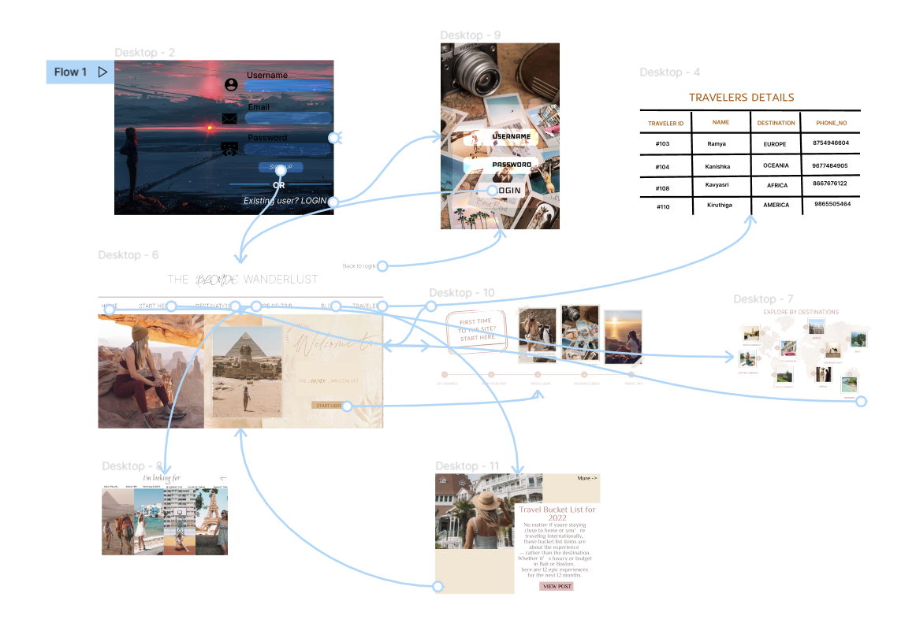

Slide 4
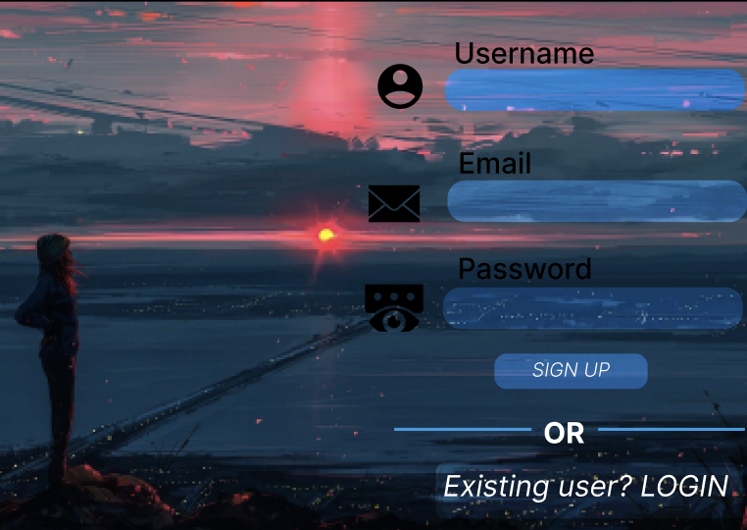

Slide 5


Slide 6


Slide 7
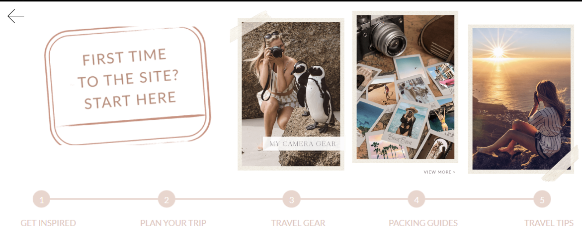

Slide 8
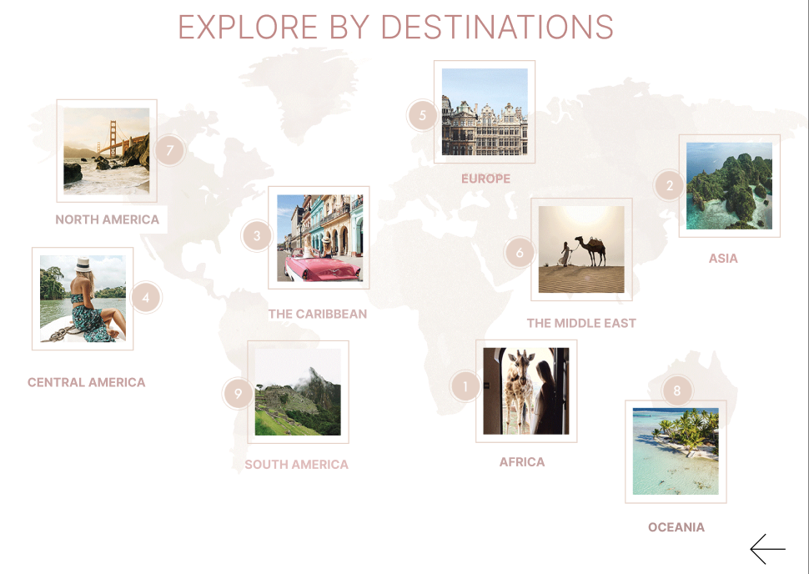

Slide 9


Slide 10


Slide 11
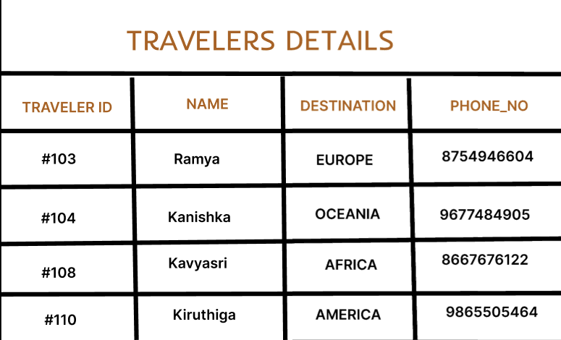

Slide 12
FIGMA LINK - https://www.figma.com/file/1v2ib2vcMwljBdDhM1z14m/Untitled?node-id=0%3A1
GITHUB LINK –
https://github.com/Kavyasri08/Travel-Wanderlust.git

